Slide 1
Bridging Combinatorial and Algebraic proof
An Algebraic Approach with Agda
游棫荃

Slide 2
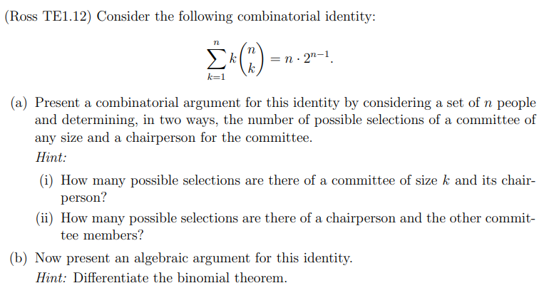
Introduction
What are combinatorial and algebraic proofs (or argument) ?

Slide 3
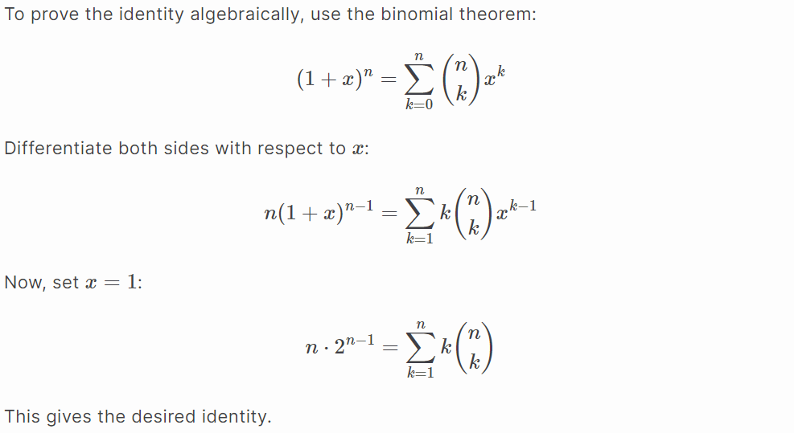
Algebraic proof

Slide 4
Comparison
Combinatorial proofs are often more intuitive and easier to understand due to their reliance on counting and reasoning about sets, which often makes them more accessible.
Algebraic proofs, while more formal, typically require the buildup of numerous auxiliary lemmas and the use of more complex mathematical tools such as calculus and generating functions. This complexity can make proving intricate combinatorial identities in Agda a challenging task.

Slide 5
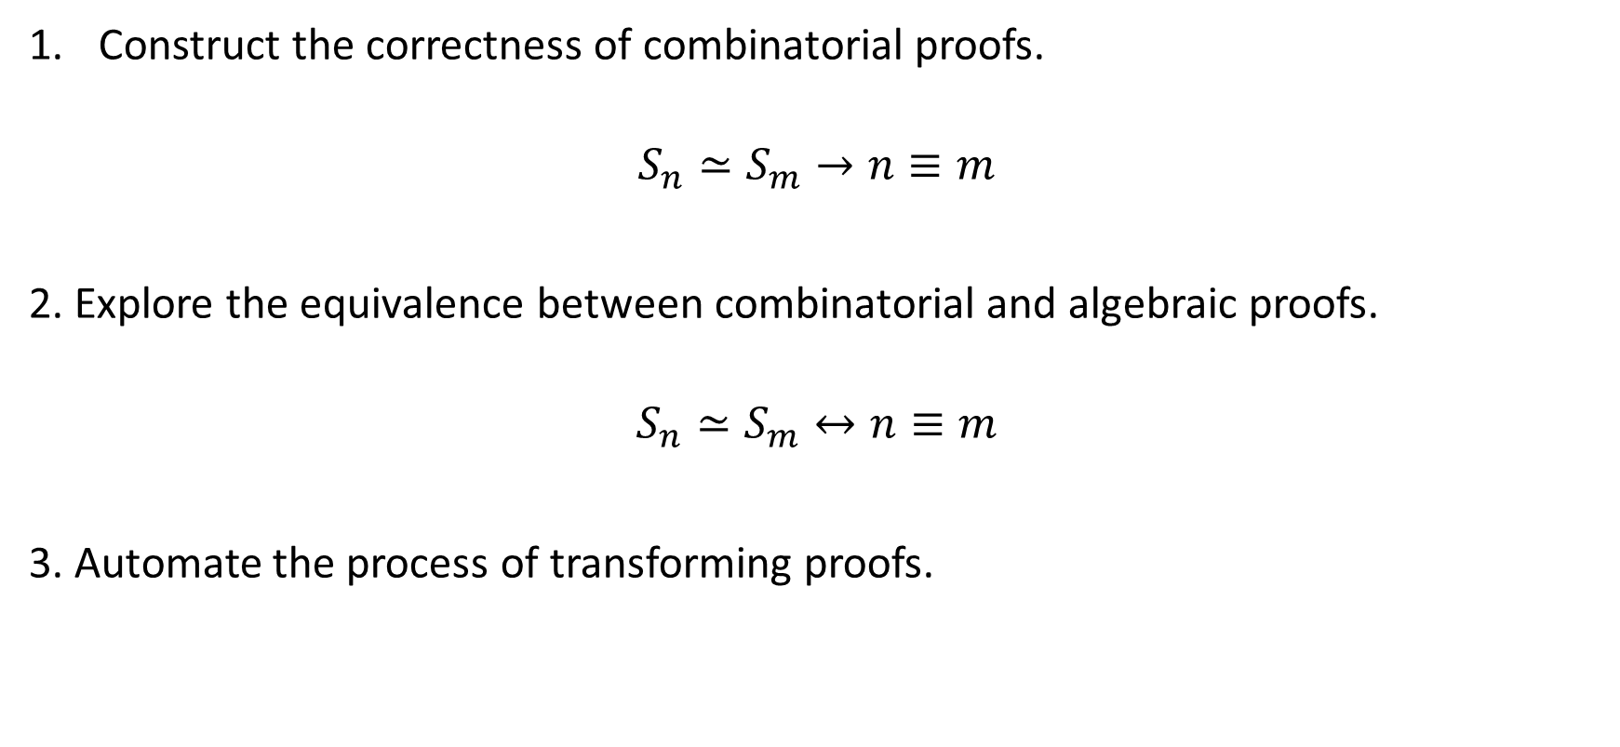
Goal
Construct the correctness of combinatorial proofs.
$$S_{n}≃S_{m}→n≡m$$
2. Explore the equivalence between combinatorial and algebraic proofs.
$$S_{n}≃S_{m}↔n≡m$$
3. Automate the process of transforming proofs.

Slide 6

Key ideas
1. The same algebraic structure underlying both sets and natural numbers
2. FinSet: Serves as a medium between sets and natural numbers
3. Embedding: An sufficient condition for transforming proofs

Slide 7
1. Algebraic structure

Slide 8
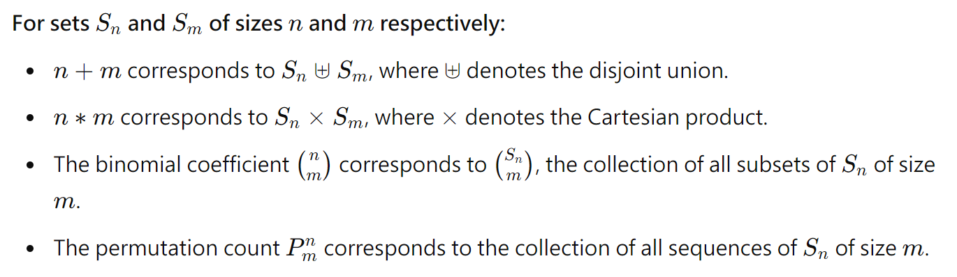
1.1 Corresponding Operations

Slide 9
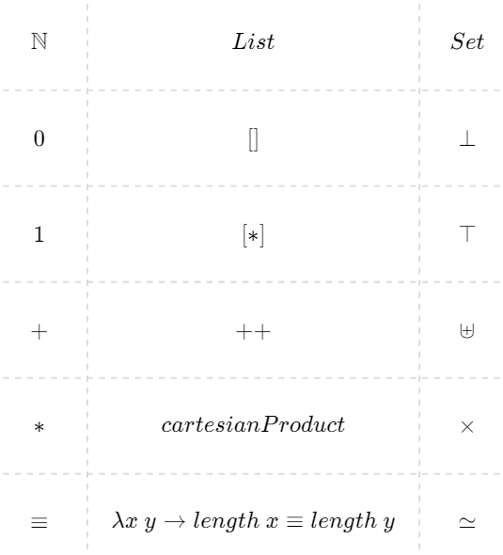
1.2 N, List and Set
cartesianProduct : List A → List B → List (A × B)

Slide 10
2. FinSet

Slide 11
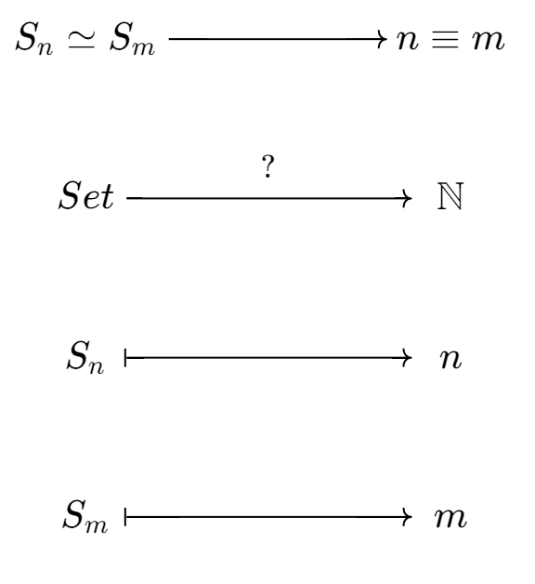
2.1 Why we need medium (FinSet)?

Slide 12
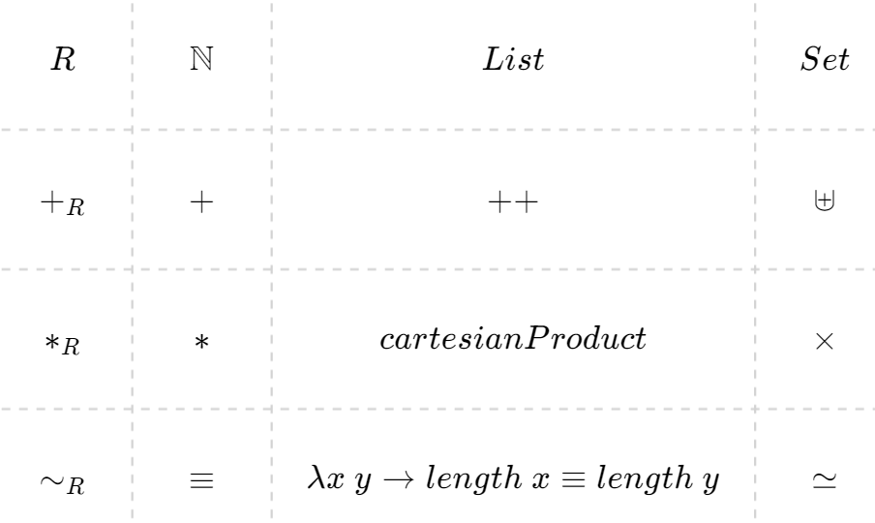
2.1 Why we need medium (FinSet)?
FinSet

Slide 13
2.2 Membership of List
data _∈_ (a : A) : (x : List A) → Set i where
here : ∀ {x} → a ∈ (a ∷ x)
there : ∀ {b} {x} → (a∈x : a ∈ x) → a ∈ (b ∷ x)
_∉_ : (a : A) → (x : List A) → Set i
a ∉ x = ¬ (a ∈ x)
data _∈₁_ (a : A) : (x : List A) → Set i where
here₁ : ∀ {x} → (a∉x : a ∉ x) → a ∈₁ (a ∷ x)
there₁ : ∀ {b x} → (a∉b : a ∉ [ b ]) → (a∈₁x : a ∈₁ x) → a ∈₁ (b ∷ x)

Slide 14
2.2 FinSet
A finite set is defined as "the existence of a list that enumerates all the inhabitants of the type."
record FinSet {i : Level} : Set (lsuc i) where
field
Carrier : Set i
list : List Carrier
-- Every inhabitant of Carrier is a member of the list.
enum : (aₑ : Carrier) → aₑ ∈ list
-- Every element in list appears exactly once.
once : (a₁ : Carrier) → a₁ ∈ list → a₁ ∈₁ list

Slide 15
2.3 Operators and relation
_R+_ = λ X Y → record
{ Carrier = Carrier X ⊎ Carrier Y
; list = (map inj₁ (list X)) ++ (map inj₂ (list Y))
; ...}
_R*_ = λ X Y → record
{ Carrier = Carrier X × Carrier Y
; list = cartesianProduct (list X) (list Y)
; ...}
_~_ = λ X Y → Carrier X ≃ Carrier Y

Slide 16
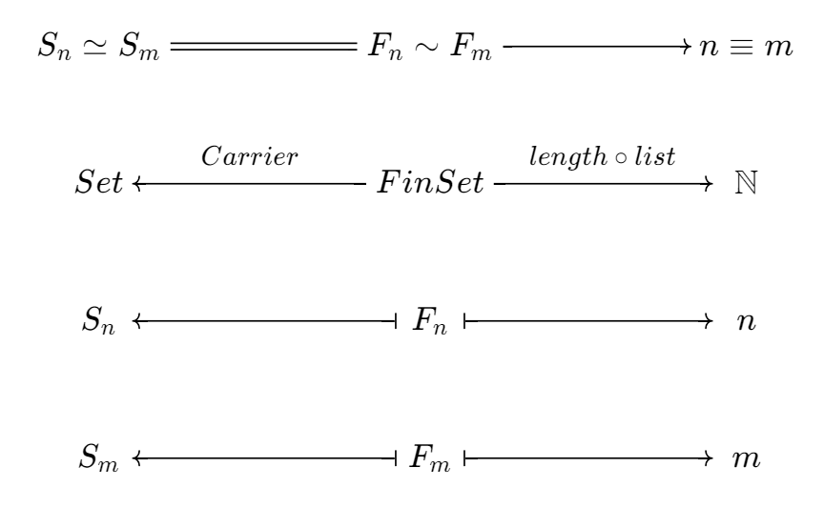

Slide 17
3. Embedding

Slide 18
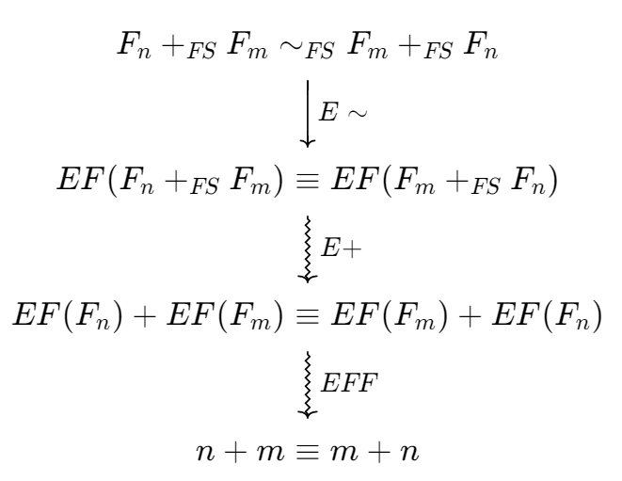
3.1 Why we need Embedding?

Slide 19
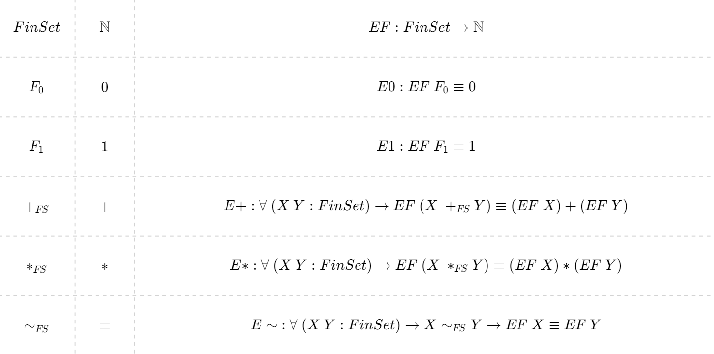
3.2 Embedding

Slide 20

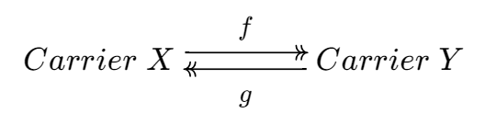














3.3 E$\sim$
. . .

Slide 21
Example 1 : Commutativity of Addition
(n m : ℕ) → n + m ≡ m + n

Slide 22
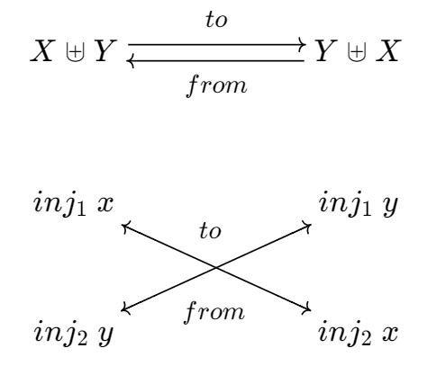
Commutativity of Addition Combinatorial proof
combi-pf : (n m : ℕ) → ((F n) R+ (F m)) ~ ((F m) R+ (F n))
combi-pf n m = record { to = λ {(inj₁ x) → inj₂ x ; (inj₂ y) → inj₁ y}
; from = λ {(inj₁ x) → inj₂ x ; (inj₂ y) → inj₁ y}
...}

Slide 23
Commutativity of Addition Transform into Algebraic proof
algeb-pf : (n m : ℕ) → n + m ≡ m + n
algeb-pf n m =
begin
n + m
≡⟨ sym (cong₂ _+_ (EFF n) (EFF m)) ⟩
EF (F n) + EF (F m)
≡⟨ sym (E+ (F n) (F m)) ⟩
EF ((F n) R+ (F m))
≡⟨ E~ ((F n) R+ (F m)) ((F m) R+ (F n)) (combi-pf n m) ⟩
EF ((F m) R+ (F n))
≡⟨ E+ (F m) (F n) ⟩
EF (F m) + EF (F n)
≡⟨ cong₂ _+_ (EFF m) (EFF n) ⟩
m + n
∎
(combi-pf n m)
EFF : ∀ (n : ℕ) → EF (F n) ≡ n

Slide 24
Commutativity of Addition Comparison
-- By framework
combi-pf : (n m : ℕ) → ((F n) R+ (F m)) ~ ((F m) R+ (F n))
combi-pf n m = record {...}
algeb-pf : (n m : ℕ) → n + m ≡ m + n
algeb-pf n m = auto combi-pf n m
-- Normal, plfa
lemma-1 : ∀ (m : ℕ) → m + zero ≡ m
lemma-1 zero = refl
lemma-1 (suc m) rewrite lemma-1 m = refl
lemma-2 : ∀ (m n : ℕ) → m + suc n ≡ suc (m + n)
lemma-2 zero n = refl
lemma-2 (suc m) n rewrite lemma-2 m n = refl
+-comm : ∀ (m n : ℕ) → m + n ≡ n + m
+-comm m zero rewrite lemma-1 m = refl
+-comm m (suc n) rewrite lemma-2 m n | +-comm m n = refl

Slide 25
Example 2 : Associativity of Product
(n m l : ℕ) → n * (m * l) ≡ (n * m) * l

Slide 26
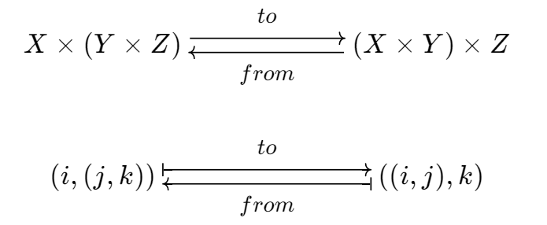
Associativity of Product Combinatorial proof
combi-pf2 : (n m l : ℕ) → ((F n) R* ((F m) R* (F l))) ~ (((F n) R* (F m)) R* (F l))
combi-pf2 n m l = record { to = λ {(i , (j , k)) → ((i , j) , k)}
; from = λ {((i , j) , k) → (i , (j , k))}
...}

Slide 27
Associativity of Product Transform into Algebraic proof
algeb-pf2 : (n m l : ℕ) → n * (m * l) ≡ (n * m) * l
algeb-pf2 n m l =
begin
n * (m * l)
≡⟨ sym (cong (_* (m * l)) (EFF n)) ⟩
EF (F n) * (m * l)
≡⟨ sym (cong (EF (F n) *_) (cong₂ _*_ (EFF m) (EFF l))) ⟩
EF (F n) * (EF (F m) * EF (F l))
≡⟨ sym (cong (EF (F n) *_) (E* (F m) (F l))) ⟩
EF (F n) * EF ((F m) R* (F l))
≡⟨ sym (E* (F n) ((F m) R* (F l))) ⟩
EF ((F n) R* ((F m) R* (F l)))
≡⟨ E~ ((F n) R* ((F m) R* (F l))) (((F n) R* (F m)) R* (F l)) (combi-pf2 n m l) ⟩
EF (((F n) R* (F m)) R* (F l))
≡⟨ E* (((F n) R* (F m))) ((F l)) ⟩
EF ((F n) R* (F m)) * EF (F l)
≡⟨ cong (_* EF (F l)) (E* (F n) (F m)) ⟩
(EF (F n) * EF (F m)) * EF (F l)
≡⟨ cong (_* EF (F l)) (cong₂ _*_ (EFF n) (EFF m)) ⟩
(n * m) * EF (F l)
≡⟨ cong ((n * m) *_) (EFF l) ⟩
(n * m) * l
∎

Slide 28
Associativity of Product Comparison
-- By framework
combi-pf2 : (n m l : ℕ) → ((F n) R* ((F m) R* (F l))) ~ (((F n) R* (F m)) R* (F l))
combi-pf2 n m l = record {...}
algeb-pf2 : (n m l : ℕ) → n * (m * l) ≡ (n * m) * l
algeb-pf2 n m l = auto combi-pf2 n m l
-- Normal, plfa *-assoc : ∀ (m n p : ℕ) → (m * n) * p ≡ m * (n * p)
*-assoc zero n p = refl
*-assoc (suc m) n p =
begin
(suc m * n) * p
≡⟨ *-distrib-+ n (m * n) p ⟩
(n + m * n) * p
≡⟨ *-assoc m n p ⟩
n * p + (m * n) * p
≡⟨⟩
suc m * (n * p)
∎

Slide 29
Conclusion
Abstraction Achievement:
Creating a promising proof system in Agda.
Term Automation:
Once Term automation is complete, the system could lower proof difficulty and improve readability in Agda.
Unfinished Work:
The proof of FinSet multiplication and the inject-∈ Lemma are still pending.

Slide 30
Future Studies
1. Additional Operations to Implement
Σ, Π, _!, P, C, _^_
2. Automatic Proof Generation Using data Term
data Term `_ _`+_ _`*_ `Σ[_∈_]_ `Π[_∈_]_ [_]`! `P[_,_] `C[_,_]
3. Term Reasoning
≈-begin_ _≈⟨_⟩_ _≈-∎

Slide 31
Thank you for listening

Slide 32
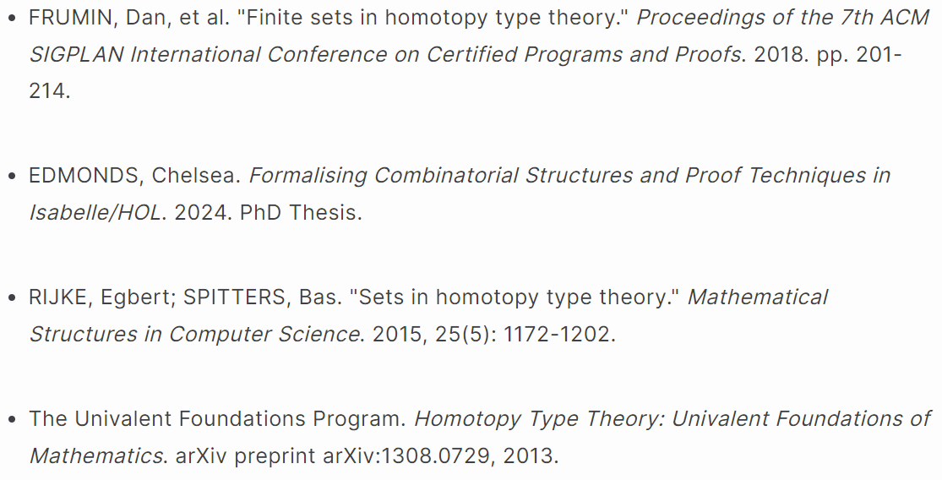
References

